Slide 1
Module 9: Firewall Technologies
Instructor Materials
Networking Security v1.0
(NETSEC)
Notes:
Networking Security (NETSEC) Module 9: Firewall Technologies

Slide 2
Instructor Materials – Module 9 Planning Guide
This PowerPoint deck is divided in two parts:
Instructor Planning Guide
Information to help you become familiar with the module
Teaching aids
Instructor Class Presentation
Optional slides that you can use in the classroom
Begins on slide # 9
Note: Remove the Planning Guide from this presentation before sharing with anyone.
For additional help and resources go to the Instructor Home Page and Course Resources for this course. You also can visit the professional development site on netacad.com, the official Cisco Networking Academy Facebook page, or Instructor Only FB group.

Slide 3
What to Expect in this Module
To facilitate learning, the following features within the GUI may be included in this module:
Feature | Description
Animations | Expose learners to new skills and concepts.
Videos | Expose learners to new skills and concepts.
Check Your Understanding(CYU) | Per topic online quiz to help learners gauge content understanding.
Interactive Activities | A variety of formats to help learners gauge content understanding.
Syntax Checker | Small simulations that expose learners to Cisco command line to practice configuration skills.
PT Activity | Simulation and modeling activities designed to explore, acquire, reinforce, and expand skills.

Slide 4
What to Expect in this Module (Cont.)
To facilitate learning, the following features may be included in this module:
Feature | Description
Hands-On Labs | Labs designed for working with physical equipment.
Class Activities | These are found on the Instructor Resources page. Class Activities are designed to facilitate learning, class discussion, and collaboration.
Module Quizzes | Self-assessments that integrate concepts and skills learned throughout the series of topics presented in the module.
Module Summary | Briefly recaps module content.

Slide 5
Check Your Understanding
Check Your Understanding activities are designed to let students quickly determine if they understand the content and can proceed, or if they need to review.
Check Your Understanding activities do not affect student grades.
There are no separate slides for these activities in the PPT. They are listed in the notes area of the slide that appears before these activities.
Notes:
5

Slide 6
Module 9: Activities
What activities are associated with this module?
Page # | Activity Type | Activity Name | Optional?
9.1.1 | Animation | Firewalls | Recommended
9.1.3 | Check Your Understanding | Identify the Type of Firewall | Recommended
9.2.3 | Check Your Understanding | Identify the Network Topology | Recommended
9.2.4 | Packet Tracer | Identify Packet Flow | Recommended
9.3.2 | Module Quiz | Firewall Technologies | Recommended

Slide 7
Module 9: Best Practices
Prior to teaching Module 9, the instructor should:
Review the activities and assessments for this module.
Try to include as many questions as possible to keep students engaged during classroom presentation.
Topic 9.1
Ask the class “Does anyone know what a firewall is?” Elicit answers from a building firewall (brick wall separating two sections in a building), car firewall (metal and fireproofing material between the driver and engine), and a network firewall.
Ask the class “Can anyone tell me how a network firewall works?” It enables inside generated traffic to go out and come back in while stopping outside generated traffic from coming in.
Ask the class “Can anyone tell me about the different types of network firewalls?” Elicit answers for packet-filtering (stateless) firewall, stateful firewall, application gateway firewall and next generation firewalls.
Notes:
7

Slide 8
Module 9: Best Practices (Cont.)
Topic 9.2
Ask the class “Should a host on the outside internet be allowed to ping an inside host?” No unless that host is a server for the public users (e.g., a web server).
Ask the class “Should a host on the inside network be allowed to ping a host on the internet?” Yes, inside generated traffic should be allowed to return.
Explain that we can configure different network “zones” to configure policies controlling how traffic flows between these zones.
Notes:
8

Slide 9
Module 9: Firewall Technologies
Networking Security v1.0
(NETSEC)
Notes:
Networking Security (NETSEC) Module 9: Firewall Technologies

Slide 10
Module Objectives
Module Title: Firewall Technologies
Module Objective: Explain how firewalls are implemented to provide network security.
Topic Title | Topic Objective
Secure Networks with Firewalls | Explain how firewalls are used to help secure networks.
Firewalls in Network Design | Explain design considerations for implementing firewall technologies.
Notes:
10
1 – Networking Today
1.0.2 – What will I learn to do in this module?

Slide 11
9.1 Secure Networks with Firewalls
Notes:
9: Firewall Technologies 9.1: Secure Networks with Firewalls

Slide 12
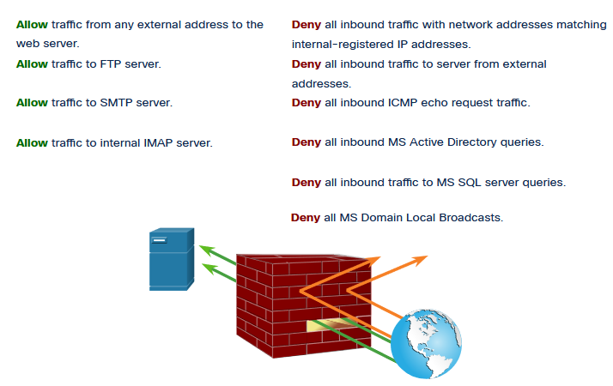
Secure Networks with Firewalls
Firewalls
All firewalls share some common properties:
Firewalls are resistant to network attacks.
Firewalls are the only transit point between internal corporate networks and external networks because all traffic flows through the firewall.
Firewalls enforce the access control policy.
Different types of firewalls have different benefits and limitations.
Notes:
9: Firewall Technologies 9.1: Secure Networks with Firewalls 9.1.1: Firewalls

Slide 13
Secure Networks with Firewalls
Types of Firewalls
It is important to understand the different types of firewalls and their specific capabilities so that the right firewall is used for each situation.
Packet Filtering (Stateless) firewalls - These are usually part of a router firewall, which permits or denies traffic based on Layer 3 and Layer 4 information. They are stateless firewalls that use a simple policy table look-up that filters traffic based on specific criteria.
Stateful firewalls – These are the most versatile and the most common firewall technologies in use. Stateful firewalls provide stateful packet filtering by using connection information maintained in a state table. Stateful filtering is a firewall architecture at the network layer.
Application Gateway (Proxy) firewalls – These filter information at Layers 3, 4, 5, and 7. Most of the firewall control and filtering is done in software. When a client needs to access a remote server, it connects to a proxy server.
Next Generation firewalls – These go beyond stateful firewalls by providing integrated intrusion prevention, application awareness and control, upgrade paths to include future information feeds, and techniques to address evolving security threats.
Notes:
9: Firewall Technologies 9.1: Secure Networks with Firewalls 9.1.2: Types of Firewalls
9.1.3: Check Your Understanding – Identify the Type of Firewall

Slide 14
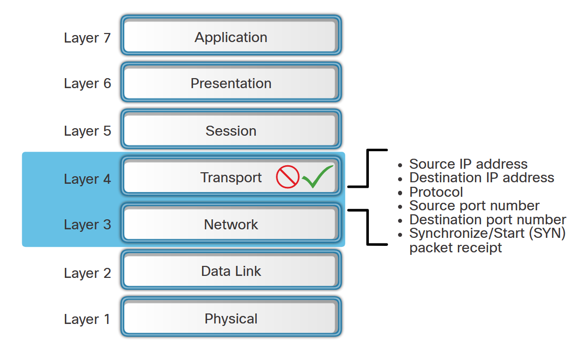
Secure Networks with Firewalls
Packet Filtering Firewall Benefits and Limitations
Benefits of Packet Filtering Firewalls:
They implement simple permit or deny rule sets.
They have a low impact on network performance.
They are easy to implement and are supported by most routers.
They provide an initial degree of security at the network layer.
They perform many of the tasks of a high-end firewall at a much lower cost.
Limitations of Packet Filtering Firewalls:
They are susceptible to IP spoofing.
They do not reliably filter fragmented packets.
They use complex ACLs, which can be difficult to implement and maintain.
They cannot dynamically filter certain services.
They are stateless.
Notes:
9: Firewall Technologies 9.1: Secure Networks with Firewalls 9.1.4: Packet Filtering Firewall Benefits and Limitations

Slide 15
Secure Networks with Firewalls
Stateful Firewall Benefits and Limitations
The table lists benefits and limitations of stateful firewalls.
Benefits | Limitations
Primary means of defense | No Application Layer inspection
Strong packet filtering | Limited tracking of stateless protocols
Improved performance over packet filters | Difficult to defend against dynamic port negotiation
Defends against spoofing and DoS attacks | No authentication support
Richer data log
Notes:
9: Firewall Technologies 9.1: Secure Networks with Firewalls 9.1.5: Stateful Firewall Benefits and Limitations

Slide 16
9.2 Firewalls in Network Design
Notes:
9: Firewall Technologies 9.2: Firewalls in Network Design

Slide 17
Firewalls in Network Design
Common Security Architectures
Firewall design is primarily about device interfaces permitting or denying traffic based on the source, the destination, and the type of traffic. Here are three common firewall designs:
Private and Public
Demilitarized Zone (DMZ)
Zone-Based Policy
Notes:
9: Firewall Technologies 9.2: Firewalls in Network Design 9.2.1: Common Security Architectures

Slide 18
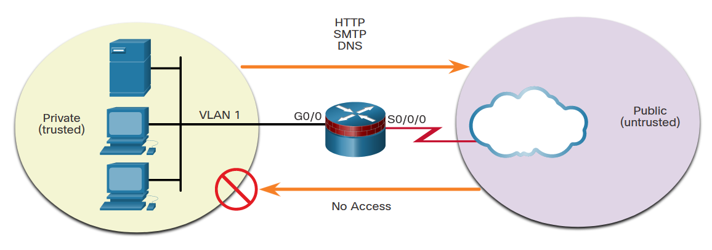
Firewalls in Network Design
Common Security Architectures (Cont.)
Private and Public - The public network (or outside network) is untrusted, and the private network (or inside network) is trusted.
Notes:
9: Firewall Technologies 9.2: Firewalls in Network Design 9.2.1: Common Security Architectures

Slide 19
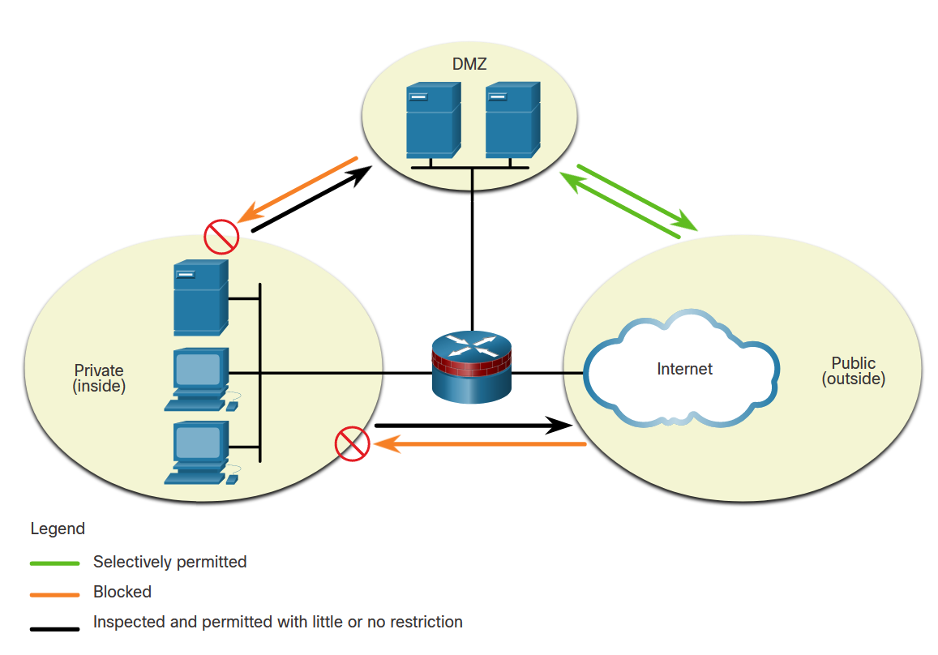
Firewalls in Network Design
Common Security Architectures (Cont.)
Demilitarized Zone (DMZ) - This is a firewall design where there is typically one inside interface connected to the private network, one outside interface connected to the public network, and one DMZ interface.
Notes:
9: Firewall Technologies 9.2: Firewalls in Network Design 9.2.1: Common Security Architectures

Slide 20
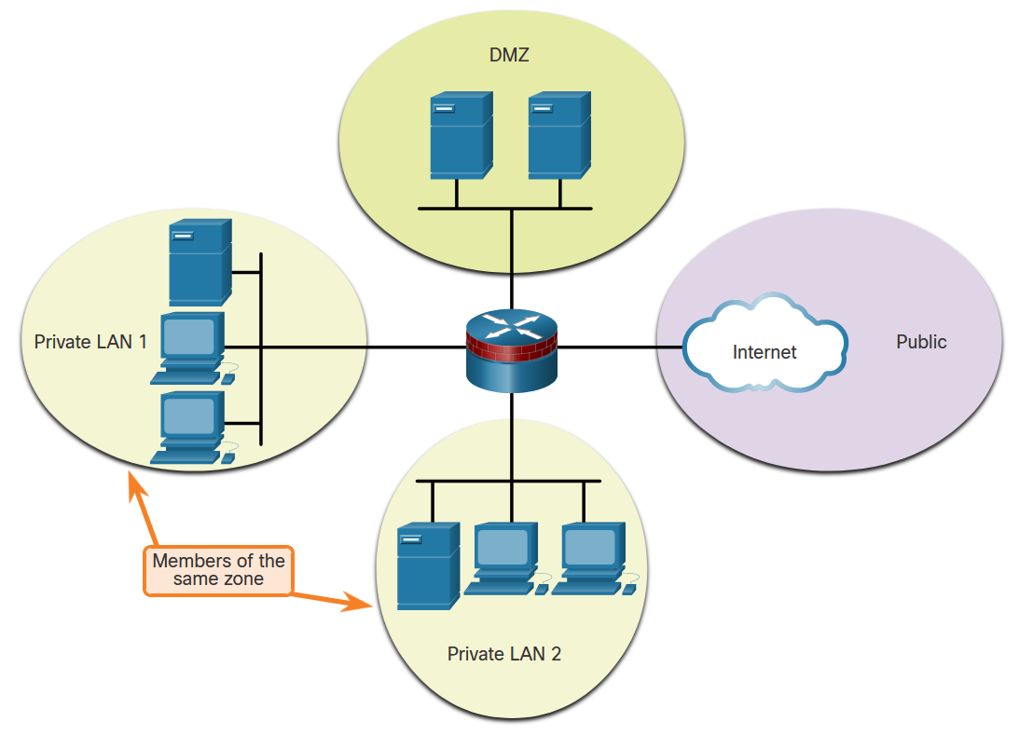
Firewalls in Network Design
Common Security Architectures
Zone-Based Policy - Zone-based policy firewalls (ZPFs) use the concept of zones to provide additional flexibility. A zone is a group of one or more interfaces that have similar functions or features. Zones help you specify where a Cisco IOS firewall rule or policy should be applied.
Notes:
9: Firewall Technologies 9.2: Firewalls in Network Design 9.2.1: Common Security Architectures

Slide 21
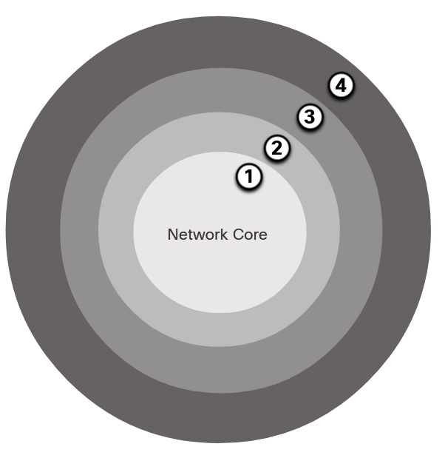
Firewalls in Network Design
Layered Defense
A layered defense uses different types of firewalls that are combined in layers to add depth to the security of an organization. Policies can be enforced between the layers and inside the layers. The following example shows four layers of security.
Network Core security - Protects against malicious software and traffic anomalies, enforces network policies, and ensures survivability
Perimeter security - Secures boundaries between zones
Communications security - Provides information assurance
Endpoint security - Provides identity and device security policy compliance
Notes:
9: Firewall Technologies 9.2: Firewalls in Network Design 9.2.2: Layered Defense
9.2.3: Check Your Understanding – Identify Basic Security Architecture for Firewalls

Slide 22
Firewalls in Network Design
Layered Defense (Cont.)
This partial list of best practices can serve as a starting point for a firewall security policy.
Position firewalls at security boundaries. Firewalls are a critical part of network security, but it is unwise to rely exclusively on a firewall for security.
Deny all traffic by default.
Permit only services that are needed.
Ensure that physical access to the firewall is controlled.
Regularly monitor firewall logs.
Practice change management for firewall configuration changes.
Remember that firewalls primarily protect from technical attacks originating from the outside.
Notes:
9: Firewall Technologies 9.2: Firewalls in Network Design 9.2.2: Layered Defense
9.2.3: Check Your Understanding – Identify Basic Security Architecture for Firewalls

Slide 23
Firewalls in Network Design
Packet Tracer - Identify Packet Flow
In this Packet Tracer activity, you will observe packet flow in a LAN and WAN topology. You will also observe how the packet flow path may change when there is a change in the network topology.
Notes:
9: Firewall Technologies 9.2: Firewalls in Network Design 9.2.4: Packet Tracer - Identify Packet Flow

Slide 24
9.3 Firewall Technologies Summary
Notes:
9: Firewall Technologies 9.3: Firewall Technologies Summary

Slide 25
Firewall Technologies Summary
What Did I Learn in this Module?
Packet filtering (stateless) firewalls provide Layer 3 and sometimes Layer 4 filtering.
A stateful inspection firewall allows or blocks traffic based on state, port, and protocol.
Application gateway firewalls (proxy firewall) filter information at Layers 3, 4, 5, and 7.
Next-generation firewalls provide additional services beyond application gateways, such as integrated intrusion prevention, application awareness, and techniques to address evolving security threats.
Some firewall designs are as simple as designating an outside network and inside network which are determined by two interfaces on a firewall.
Networks that require public access to services will often include a DMZ that the public can access, while strictly blocking access to the inside network.
ZPFs use the concept of zones to provide additional flexibility.
A layered security approach uses firewalls and other security measures to provide security at different functional layers of the network.
Notes:
9: Firewall Technologies 9.3: Firewall Technologies Summary 9.3.1: What Did I Learn in this Module?
9.3.2: Module Quiz

Slide 26
Firewall Technologies
New Terms and Commands
firewall packet filtering (stateless) firewall stateful firewall application gateway (proxy) firewall next generation firewall Zone-Based Policy firewall (ZPF) layered defense
Notes:
4 – Secure Device Access
New Terms and Commands

